Slide 1
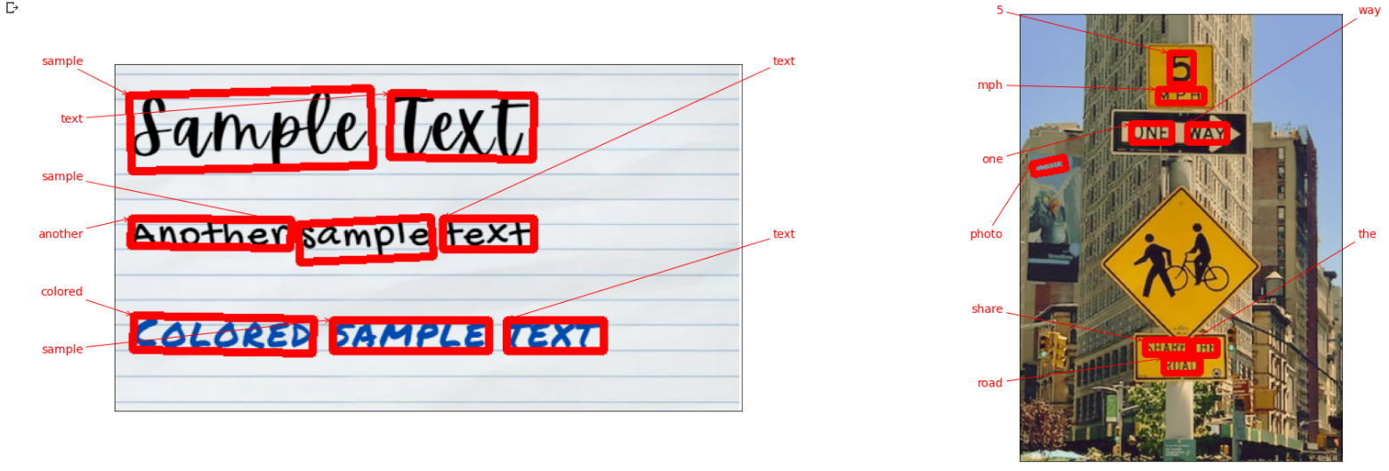
DSA3101 - 2310 Frontend OCR Extraction

Slide 2
Table of contents
01
02
03
Introduction
Client Needs
User Persona

Slide 3
Table of contents
04
05
06
Features - OCR
Demo - OCR
Features/Demo - Dashboard
07
Future Works

Slide 4
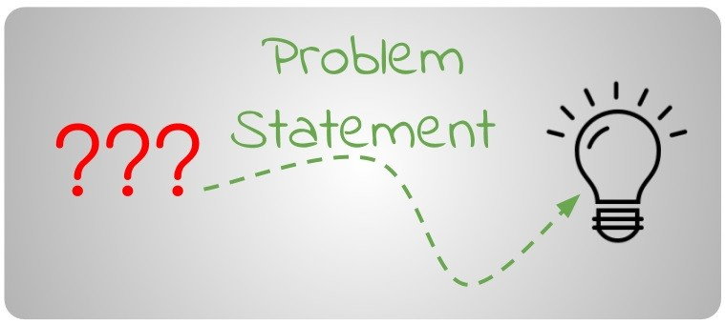
01
Introduction

Slide 5
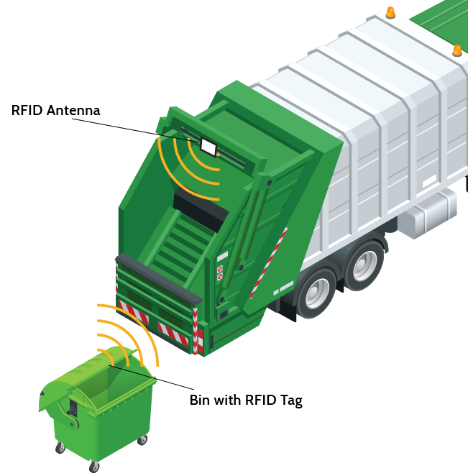

Challenges in NUS Waste Management
Introduction:
Utilizes RFID tags for efficient waste collection monitoring
RFID tags on individual bins record weight during collection

Slide 6
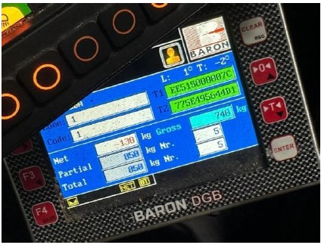
Challenges in NUS Waste Management
As a method to validate the RFID weights,
Trucks also have a panel displaying weights using the built-in weighing mechanism.

Slide 7

Challenges in NUS Waste Management
Problem:
Mismatch in weights between bin and RFID readings

Slide 8

02
Client Needs

Slide 9


Client Needs
I'm all for using technology to make our waste collection operations efficient. But those discrepancies between RFID data and actual bin weights can be a real headache. We need a reliable system that helps us meet our goals without a hitch.
Notes:
Solutions:
Primary
Making an improved dashboard for analytical purposes
Mobile friendly application for drivers to use
Secondary
Aesthetically pleasing and easy to navigate
Able to perform advanced data manipulation for future purposes (exporting or something lol)

Slide 10
Client Needs
Objectives
Primary
Implement a new OCR system
Improve data reliability
Secondary
User experience
Notes:
Solutions:
Primary
Making an improved dashboard for analytical purposes
Mobile friendly application for drivers to use
Secondary
Aesthetically pleasing and easy to navigate
Able to perform advanced data manipulation for future purposes (exporting or something lol)

Slide 11

OCR system
Phone takes a picture
Information extracted
Gross weight – 740kg
Location : …
Time : ...
Notes:
Solutions:
Primary
Making an improved dashboard for analytical purposes
Mobile friendly application for drivers to use
Secondary
Aesthetically pleasing and easy to navigate
Able to perform advanced data manipulation for future purposes (exporting or something lol)

Slide 12

03
User Persona

Slide 13

User Persona
Daily Task
Waste Collection
RFID Handling
Pain Points
Efficiency
Data Inaccuracies
Goal:
Effectively tackle inefficiencies and rectify data inaccuracies.

Slide 14

04
Features - OCR

Slide 15
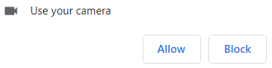
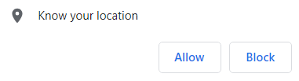
Feature – Permissions Page
Enable browser permissions for camera and location

Slide 16
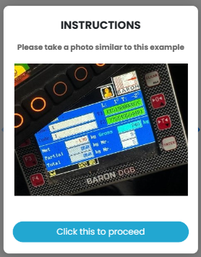
Feature – Instruction Page
Image of how the photo should be taken for OCR extraction to happen
Proceed button → User clicks on it and we bring them to capture feature

Slide 17
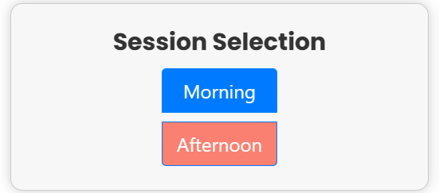

Feature – Session Selection
We will ask the user to select the session, either morning or afternoon.
Default selected based on time of day

Slide 18
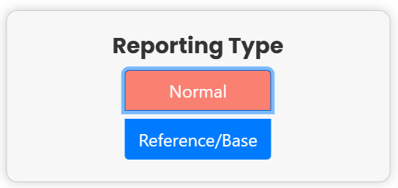
Feature – Reporting Type Selection
We will ask them to select the reporting type, if its either normal or base weight

Slide 19
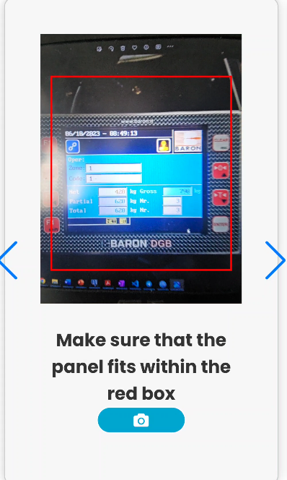
Feature – Capture Page
Guiding bounding box to tell user to align truck panel
Capture icon to take image

Slide 20
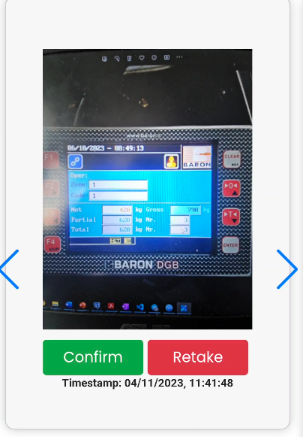
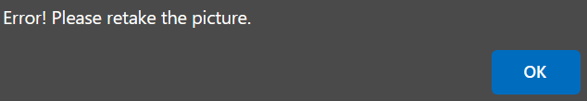
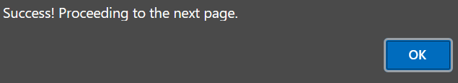
Feature – Confirm Image Page
Users can either ‘Confirm’ or ‘Retake’ image
If ‘Retake’, brings user back to upload page
If ‘Confirm’, brings user to bin center selection page
(OCR Extraction happens simultaneously)

Slide 21
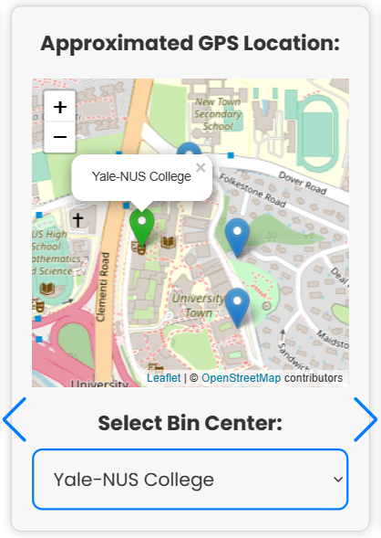
Feature – Bin Center Selection Page
Two ways of selecting bin center:
Toggling on map based on approximate location (Marker is highlighted green upon selection)
Dropdown method also allows users to select respective bin centers by name
Dynamic changes (using either method changes the other)

Slide 22
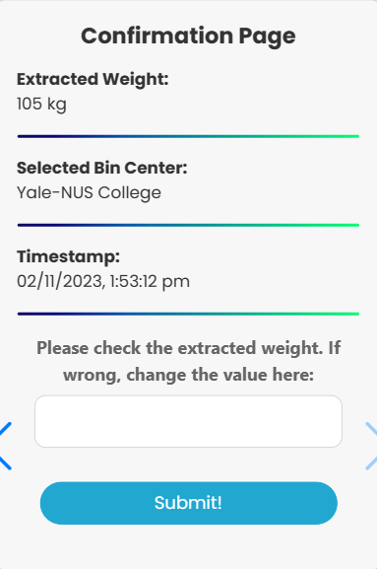
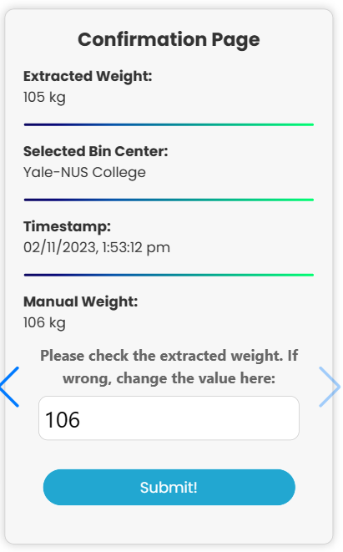
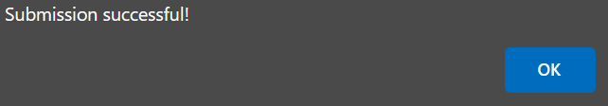
Feature – Results Page
In this page, users can verify the results
Allow for manual input if extracted weight by OCR is wrong
‘Submit’ button allows for posting of results to be saved into the database

Slide 23
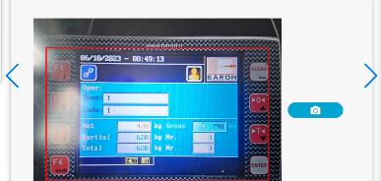
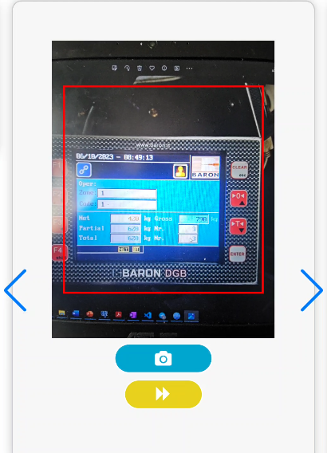
Additional Features
Ability to take images in either landscape or portrait
If OCR extraction is rejected, users have the option to retake or skip (Yellow button) in case of time constraint, allowing for flexibility

Slide 24

05
Demo
OCR

Slide 25
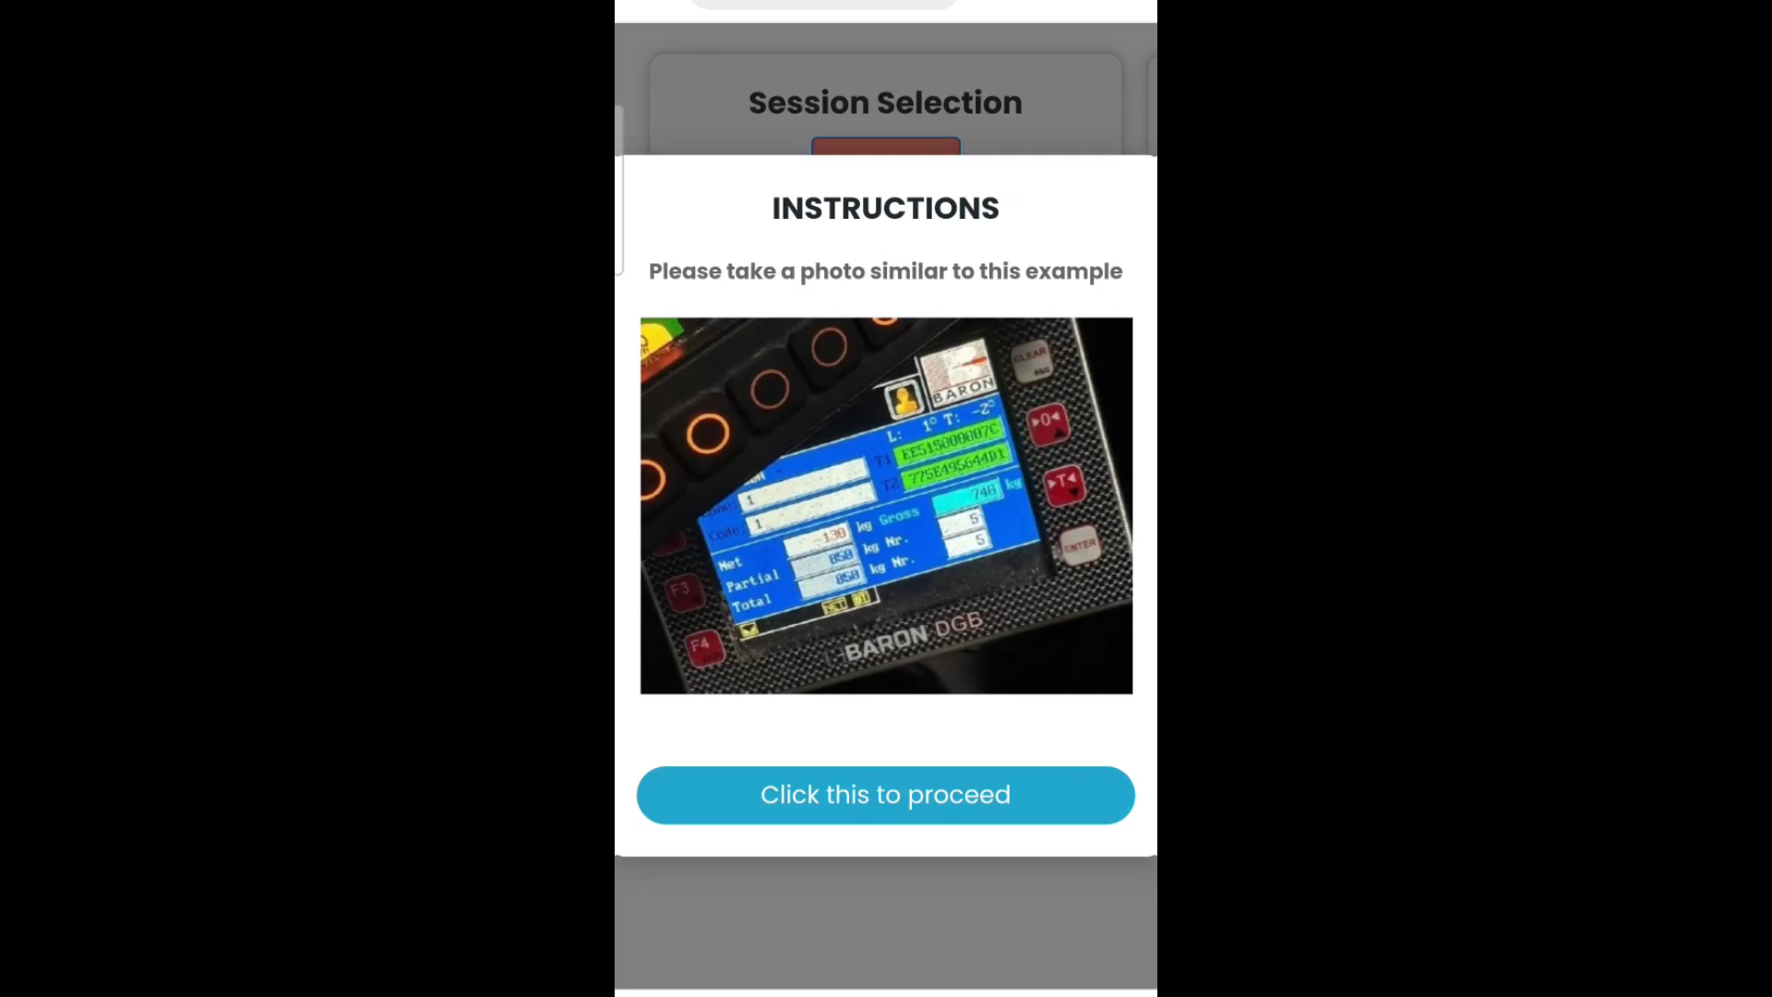
Demo – Scenario 1

Slide 26
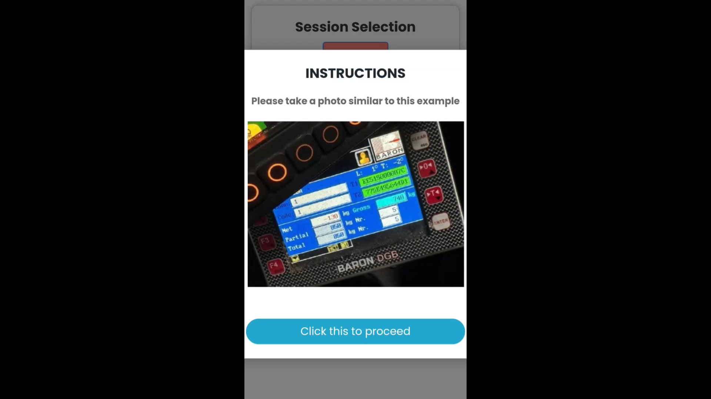
Demo – Scenario 2

Slide 27
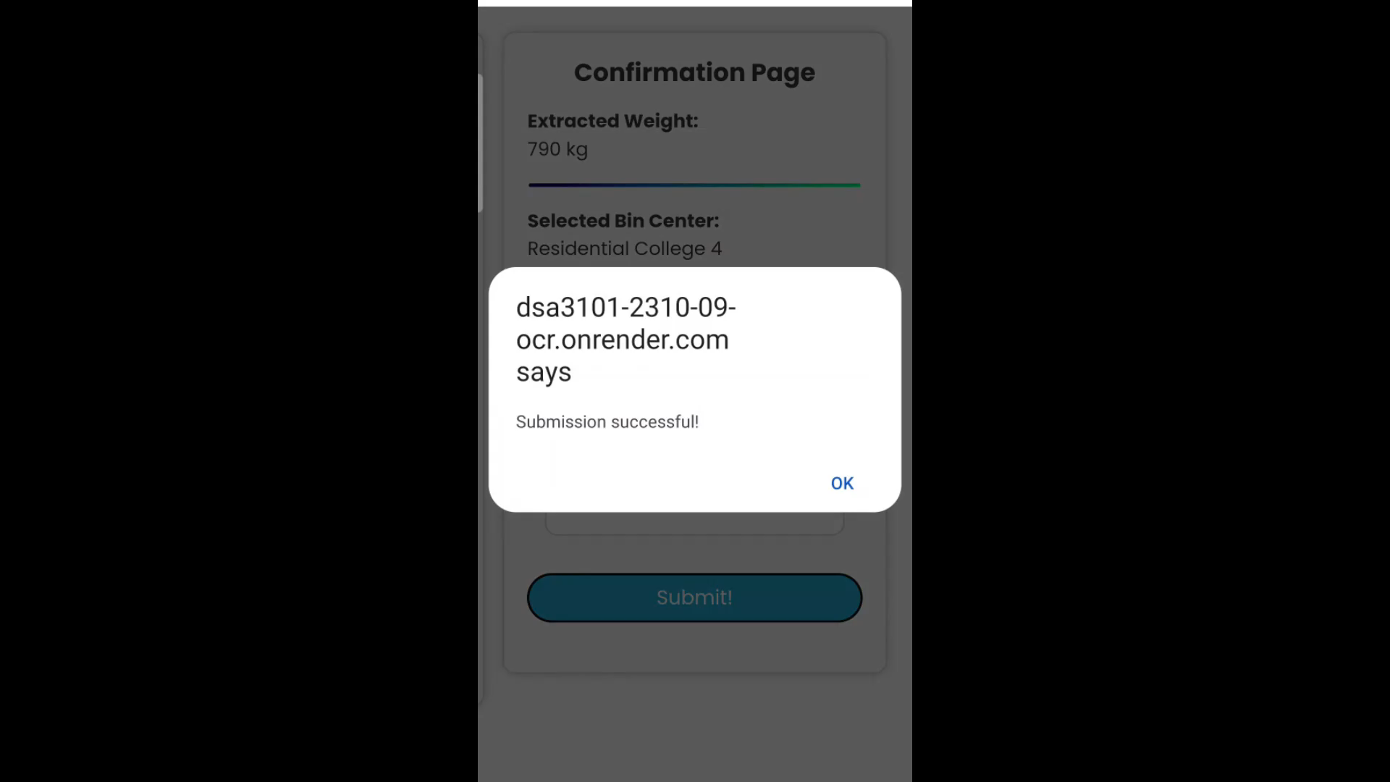
Demo – Scenario 3

Slide 28

06
Features - Analytics

Slide 29



Flow chart
OCR app
Image capture
Database
Dashboard
Notes:
Starting from ocr app, to take the image and record essential data, then transferred to database which will then be extracted for analytics

Slide 30
Aim
To provide the user with an easy way to access, sort and filter their data for further analysis.

Slide 31
Feature – Automated Data Preprocessing
Based on the raw data fetched from the SQL, the dashboard will preprocess the data and present it to the user in a user-friendly manner

Slide 32
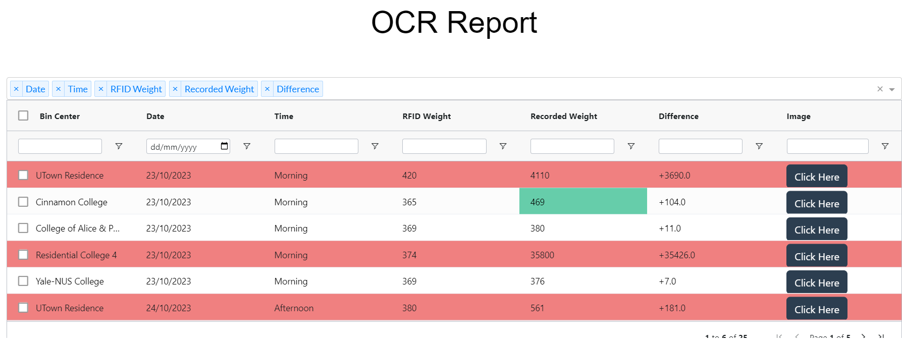
Feature – Abnormality detection
The dashboard flags out abnormal recorded weight values.
Notes:
- If the received value is above a certain threshold, the dashboard flag out the values for review by the admin manually based on the image submitted

Slide 33
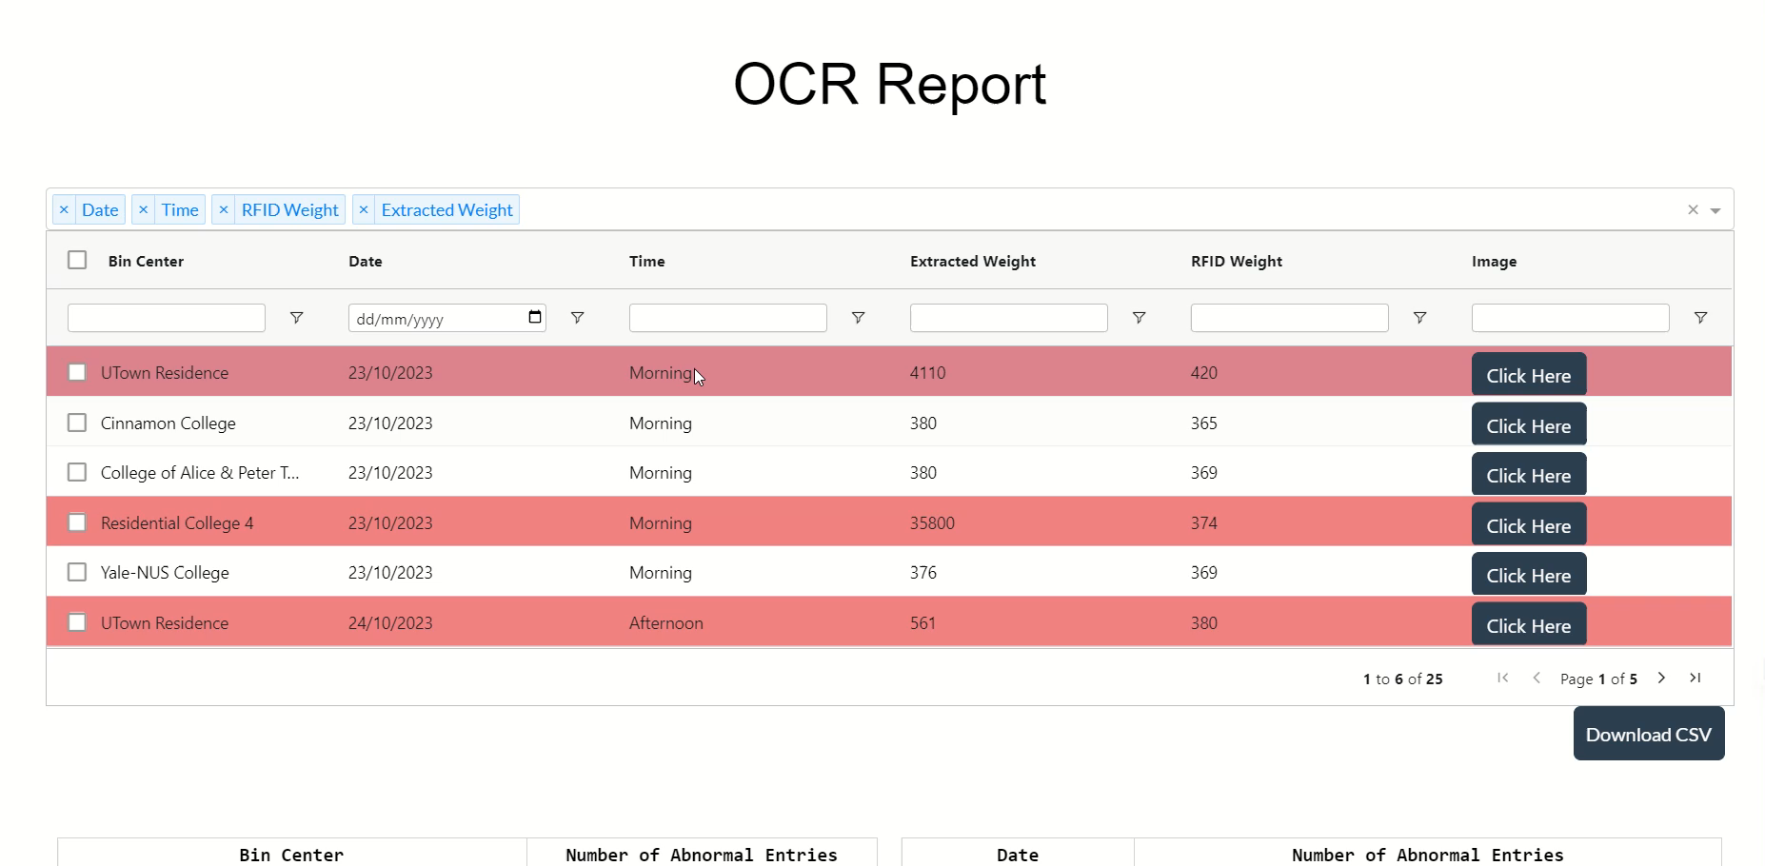
Feature – Filter Function (1)
Choosing the columns
Notes:
The admin will be able to use the filter function to do basic analysis of the data submitted

Slide 34

Feature – Filter Function (2)
Filtering the data in each column
Notes:
The admin will be able to use the filter function to do basic analysis of the data submitted

Slide 35

Feature – Selecting Rows
Ease of selection of data
Notes:
The admin will be able to use the following features to select the data (rows) needed for exporting

Slide 36

Feature – Export Function
The user can export a specific set of dataset using the filter and export CSV function for further analysis
Notes:
- The user can export a specific set of dataset using the filter and export CSV function for further analysis

Slide 37
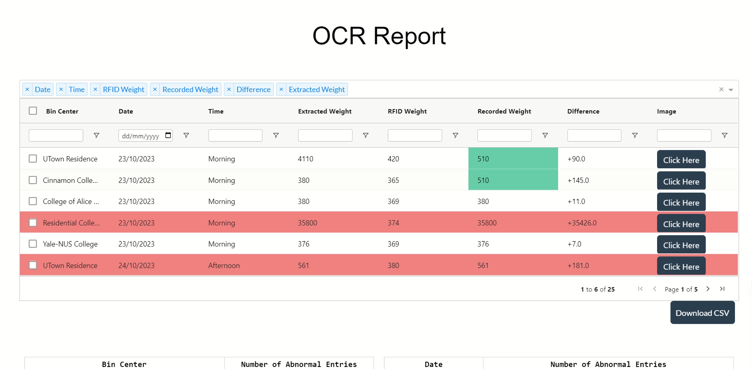
Feature – Monitor & Change OCR Readings
The admin can manually check and change the values
Notes:
- The user can export a specific set of dataset using the filter and export CSV function for further analysis

Slide 38

07
Future Works
Analytics

Slide 39
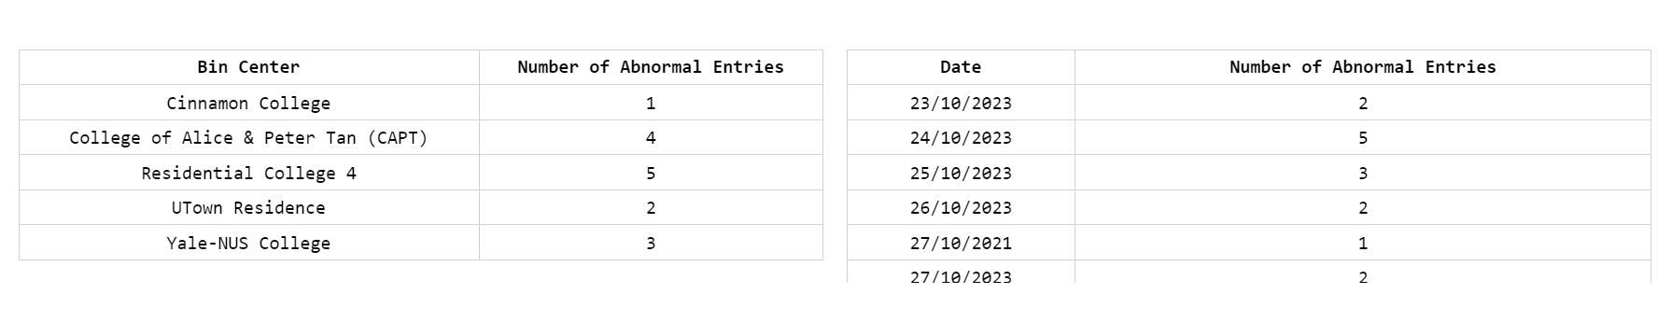
Feature – Anomaly Analytics
Present charts or insights to find trends in abnormal or misleading data entries
Notes:
- The user can export a specific set of dataset using the filter and export CSV function for further analysis

Slide 40
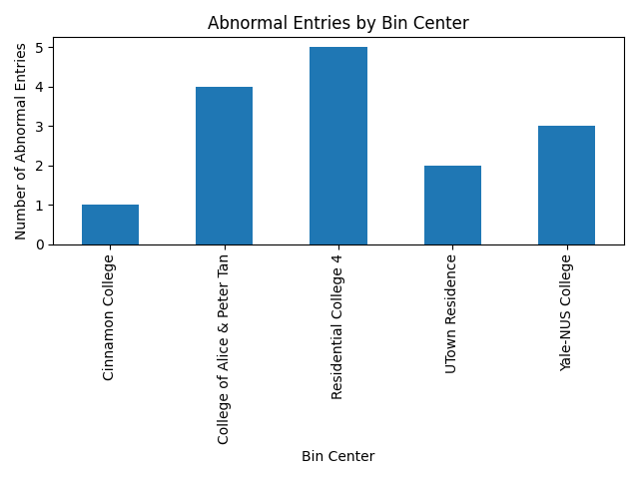
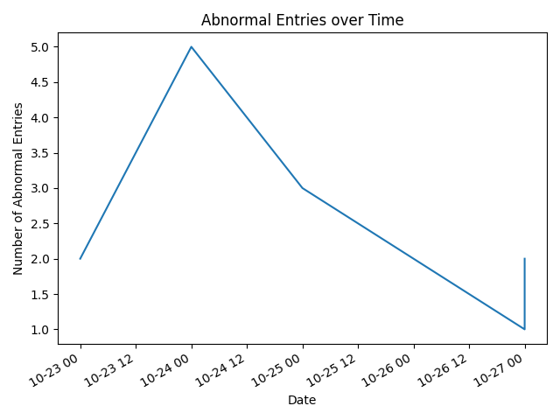
Feature – Anomaly Analytics
Notes:
- The user can export a specific set of dataset using the filter and export CSV function for further analysis

Slide 41

Google Images

Slide 42
07
Demo
Analytics

Slide 43

Demo – Scenario 1

